Slide 1
Recursive Mutex
08/06/2021

Slide 2
General
The same thread can lock the same mutex multiple times
Allows owner of the lock to lock it again
Have to explicitly unlock after the recursive call (have to unlock as many times as you lock) → recursive mutex keeps tracked how many times lock was called
If you use regular mutex in a recursive function, then that will cause a deadlock
We can recurse for an indefinite amount of times, but for each system it depends on how much stack space is left → if no space is left, if we call lock, it will return a system error and if try_lock then it will return false

Slide 3
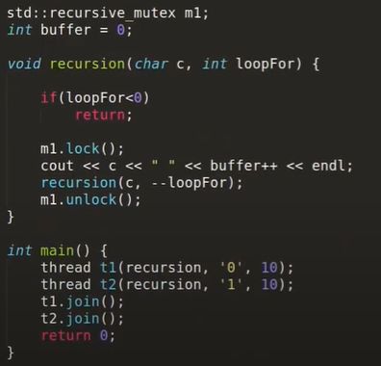
Example Program (Recursive Syntax)
T2 waits till T1 is done with all of it’s recursive calls
Works like regular recursion, just make sure unlock is happening the same amount of times as lock

Slide 4
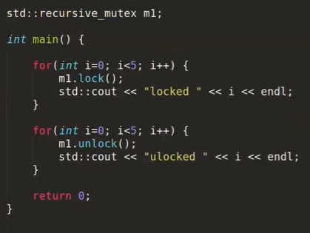
Example Program (Loops Syntax)

